Slide 1
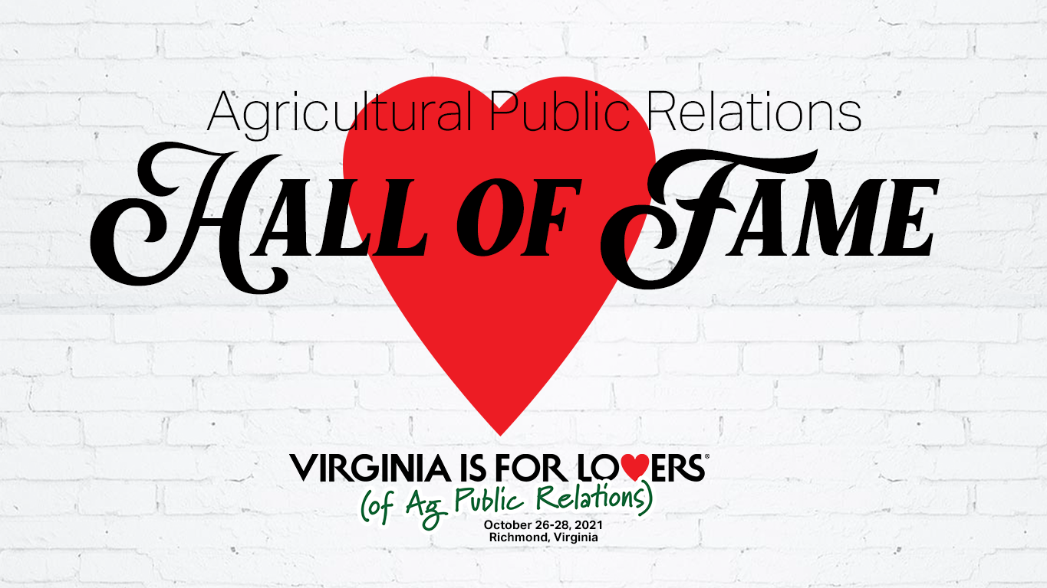

Slide 2
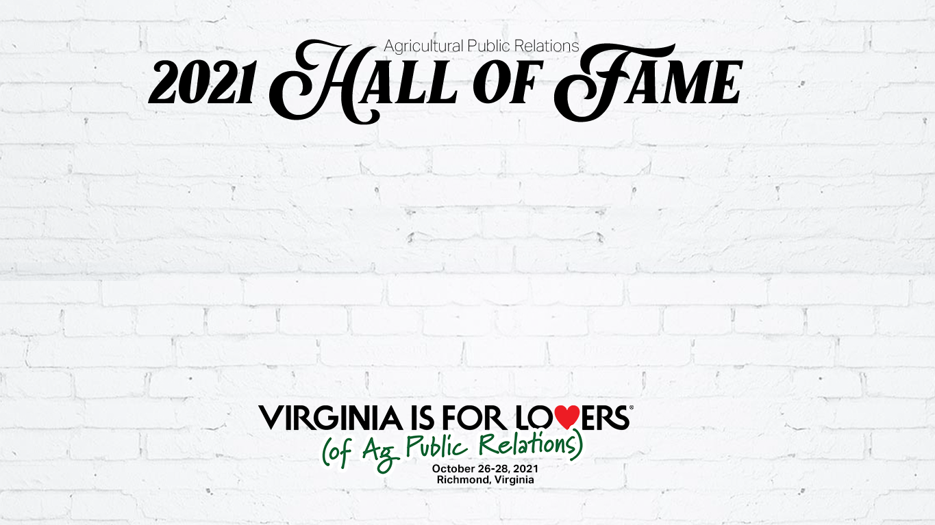
Lynn Henderson

Slide 3

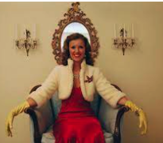
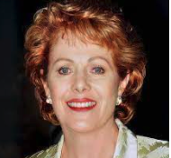
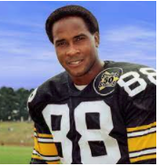
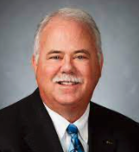
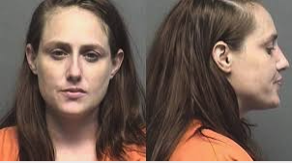
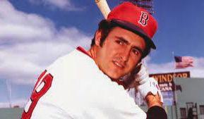
Which one of these Lynns’ is our Lynn?

Slide 5
Lynn Henderson’s Career
Graduated in 1970 from Maquoketa High School
B.S. Iowa State University, Agricultural Journalism and Mass Communications
Current Owner, Henderson Communications, LLC
Former President/CEO of Doane Agricultural Services Co.
Member of (or was):
  National 4-H Council Board of Trustees
  American Business Media’s Agri-Council
  National Agri Marketing Assn. (NAMA)
  St. Louis Agri Business Club
  Farm Foundation Roundtable
  Board of Directors of the World Agricultural Forum
  Board of Directors of the Agriculture Council of America
  NAFB
  Ag Communicators Network (AAEA)
  ARC

Slide 6
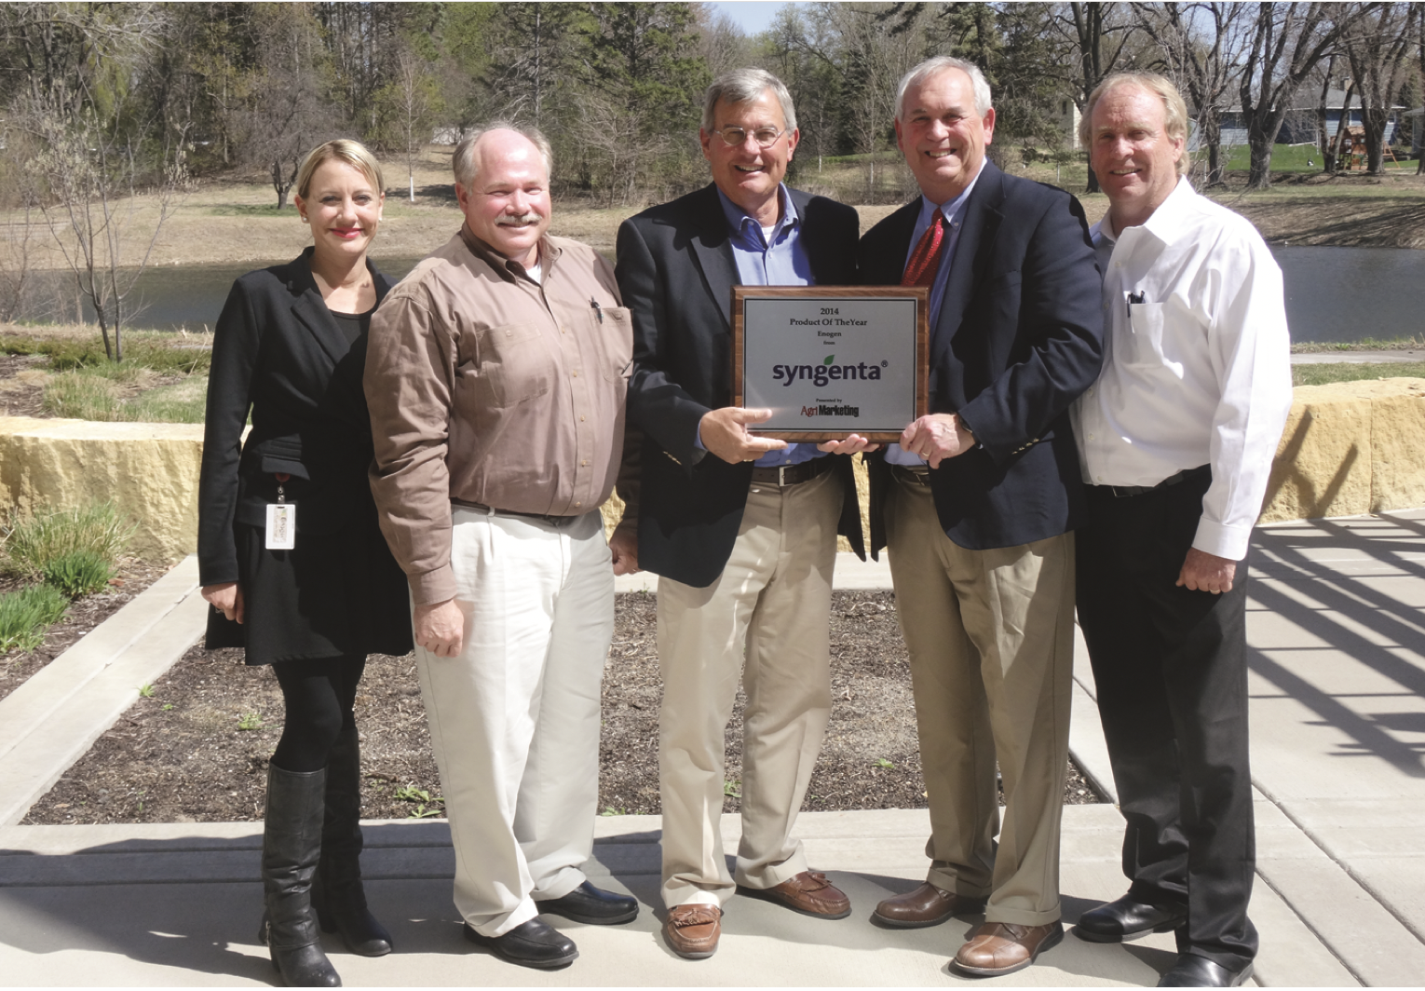
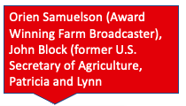
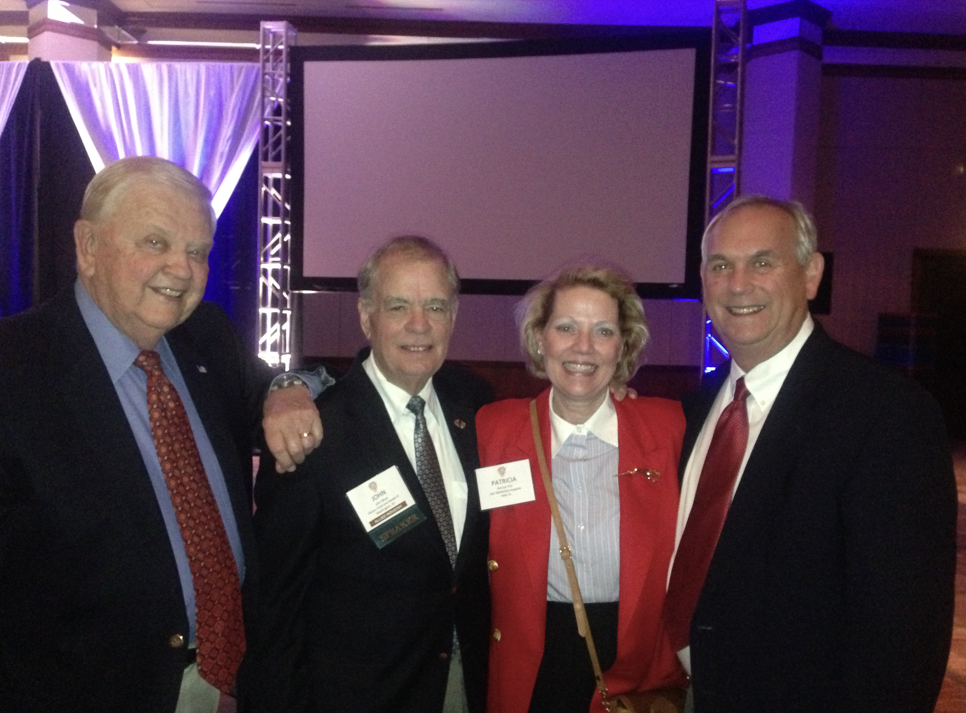
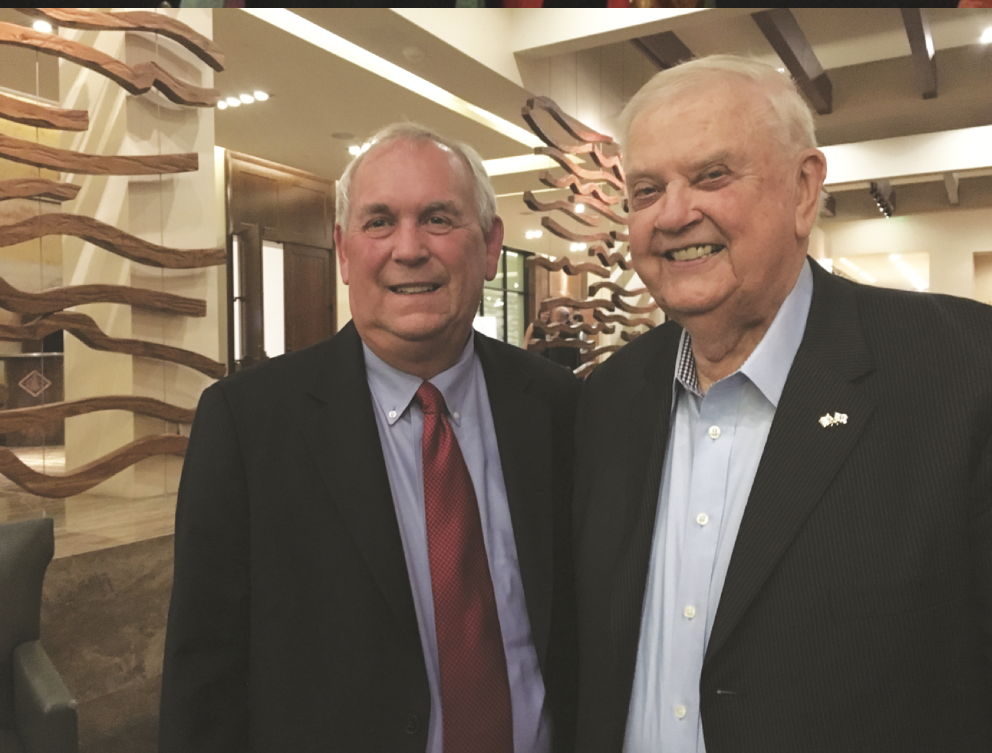

Slide 7
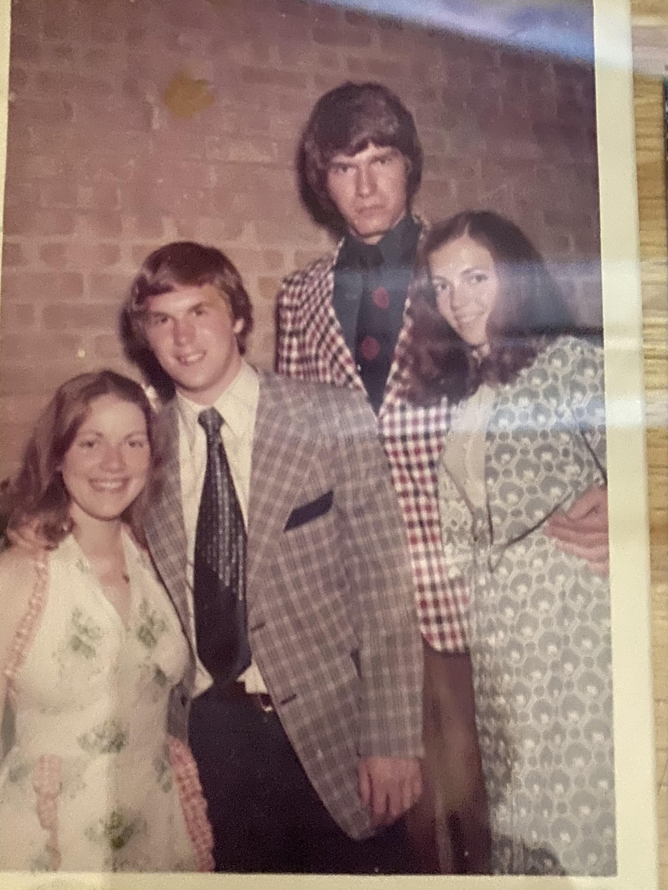
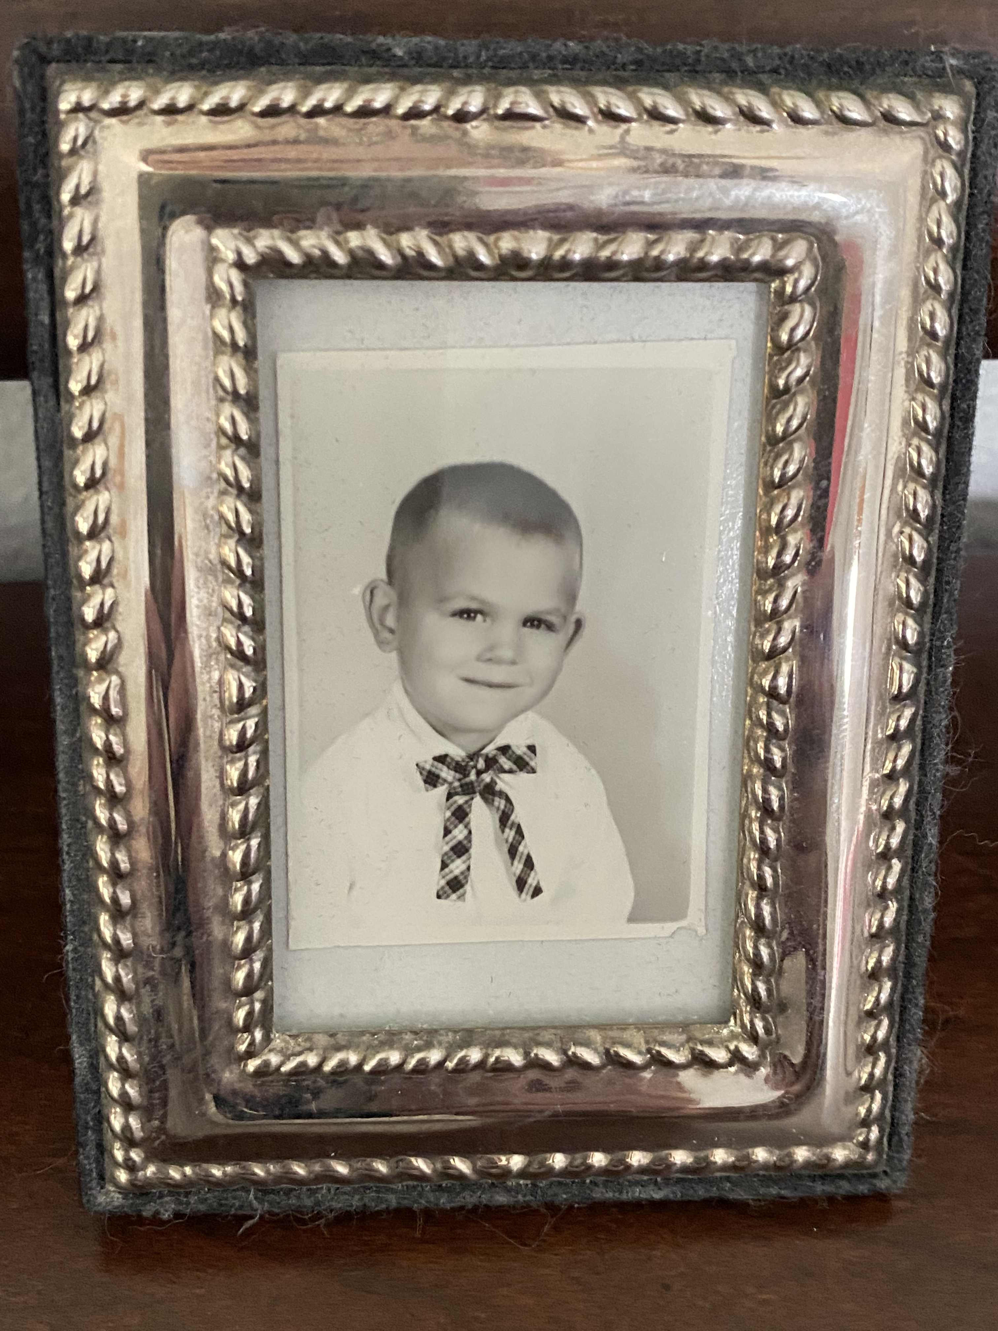
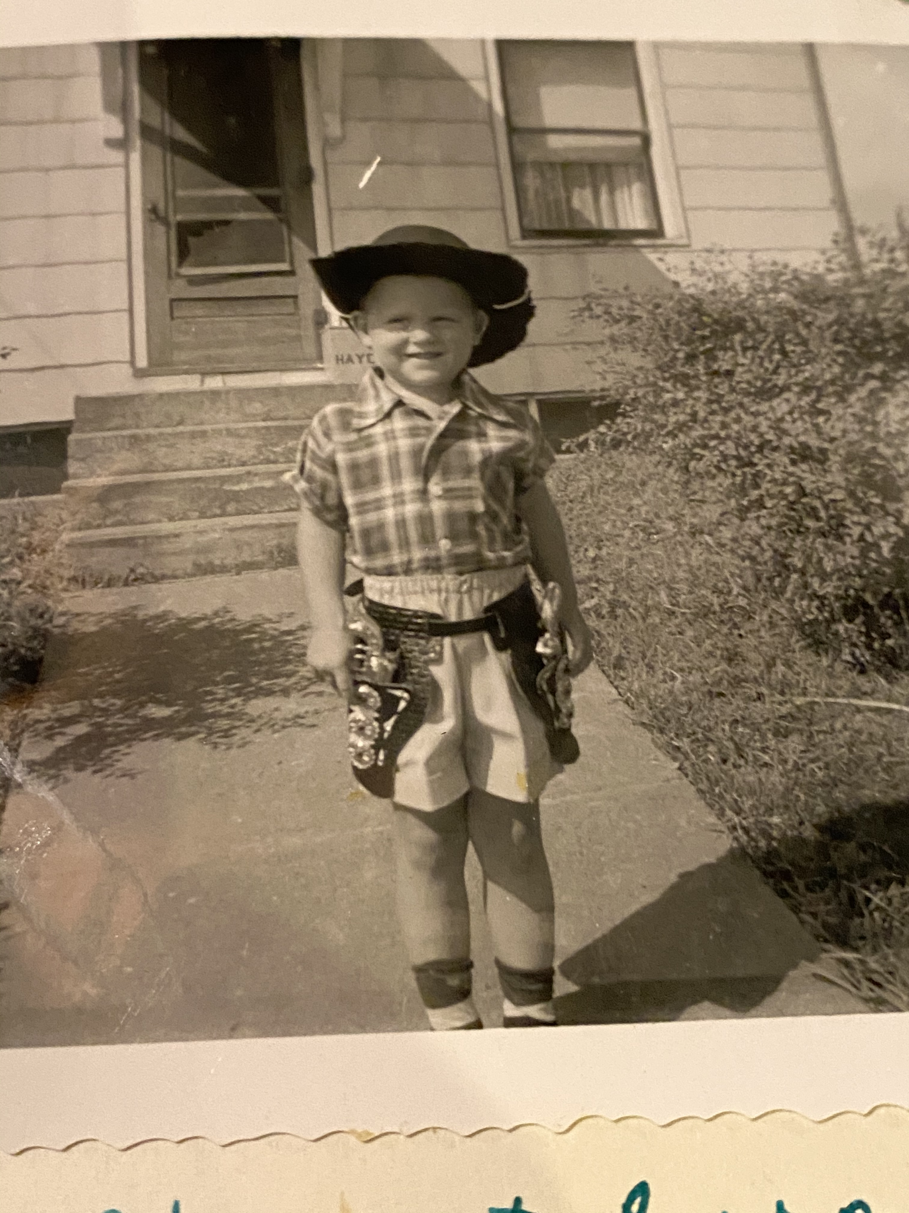
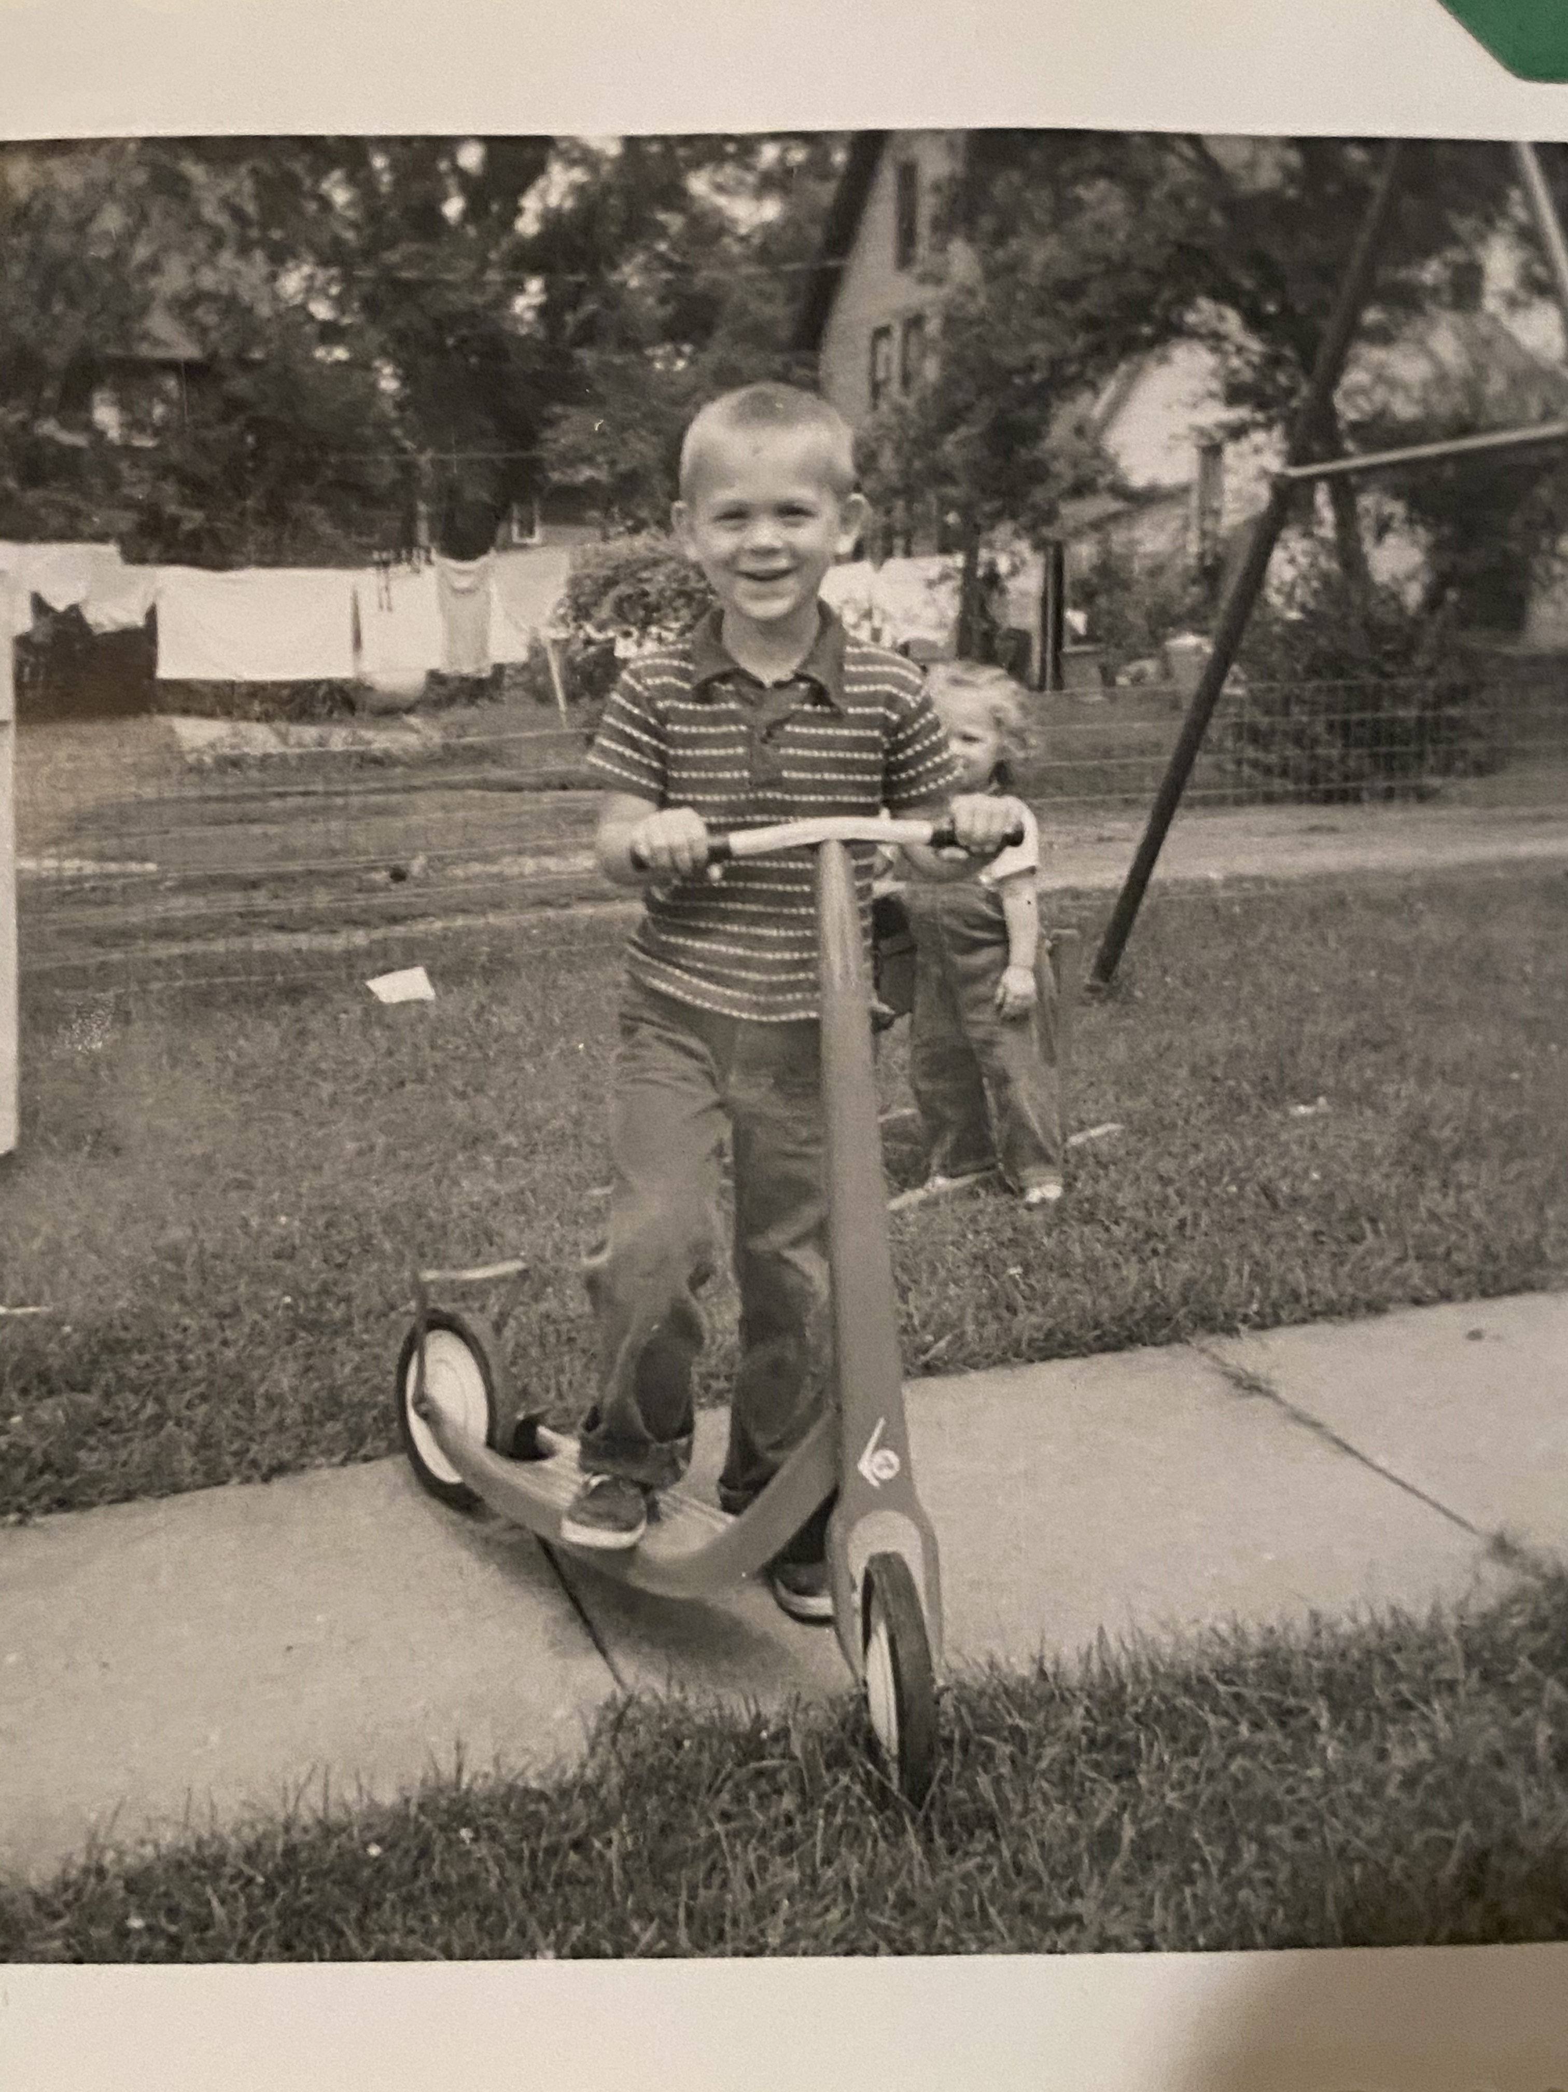
A bit about Lynn.
Lynn O. Henderson was the second child born to John and Betty Henderson.
Lynn graduated in 1970 from Maquoketa High School and set his sights on Iowa State University, where his parents had met. He studied Agricultural Journalism and Mass Communications and graduated in 1974.
He was a member of FarmHouse Fraternity while at Iowa State.
He worked as a house waiter at the Alpha Delta Pi house, where he met a cute coed named Patricia in 1974.

Slide 8
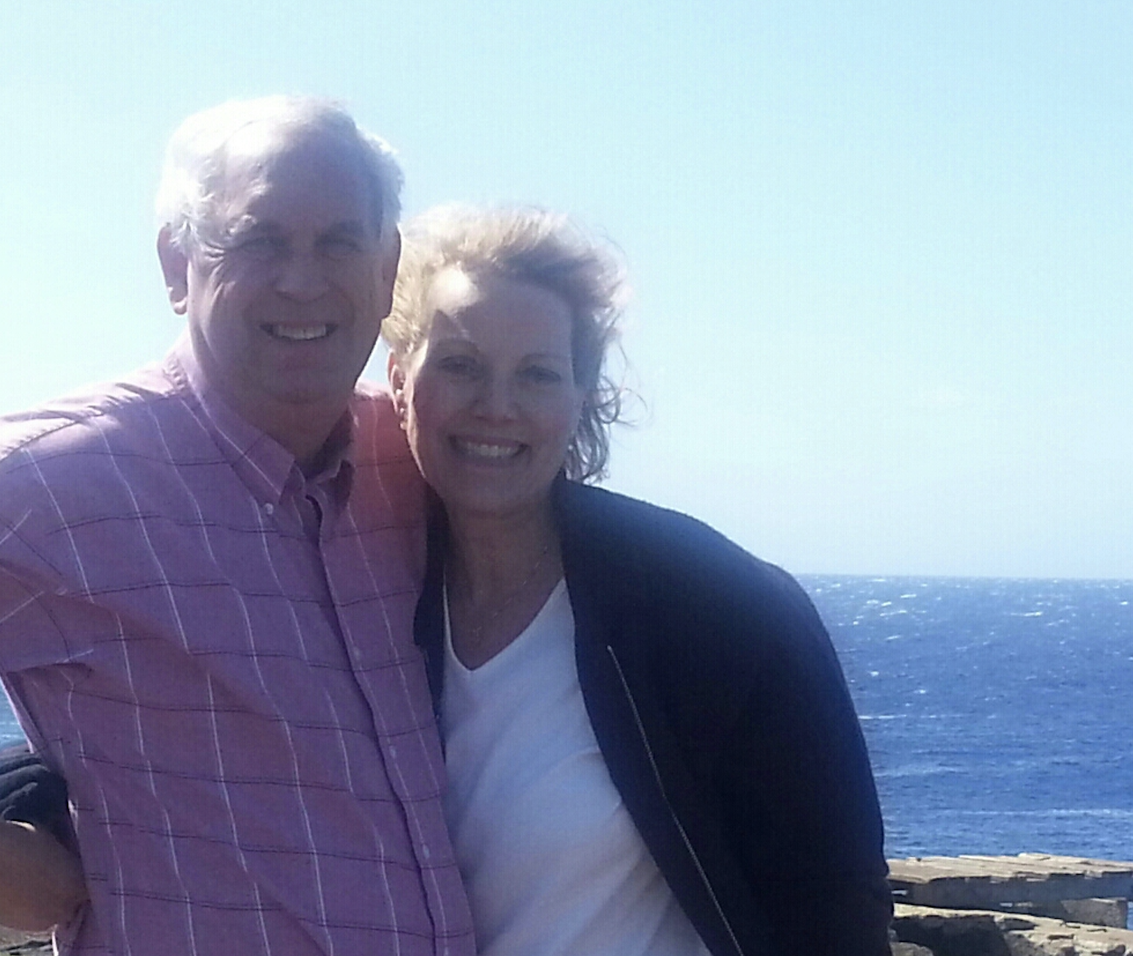
Lynn and Patricia
at the furthest U.S. point---in Hawaii, celebrating our engagement.
2012
Lynn lived in Chicago and St. Louis.
After the passing of his wife Judy in 2012, he reunited with a long-lost friend.
He moved back to Iowa and married Patricia Tice, the cute coed, in 2013, after 37 years of not seeing one another.
Patricia and Lynn make their home at Sunrise Acres, in Dallas County, Iowa.

Slide 9
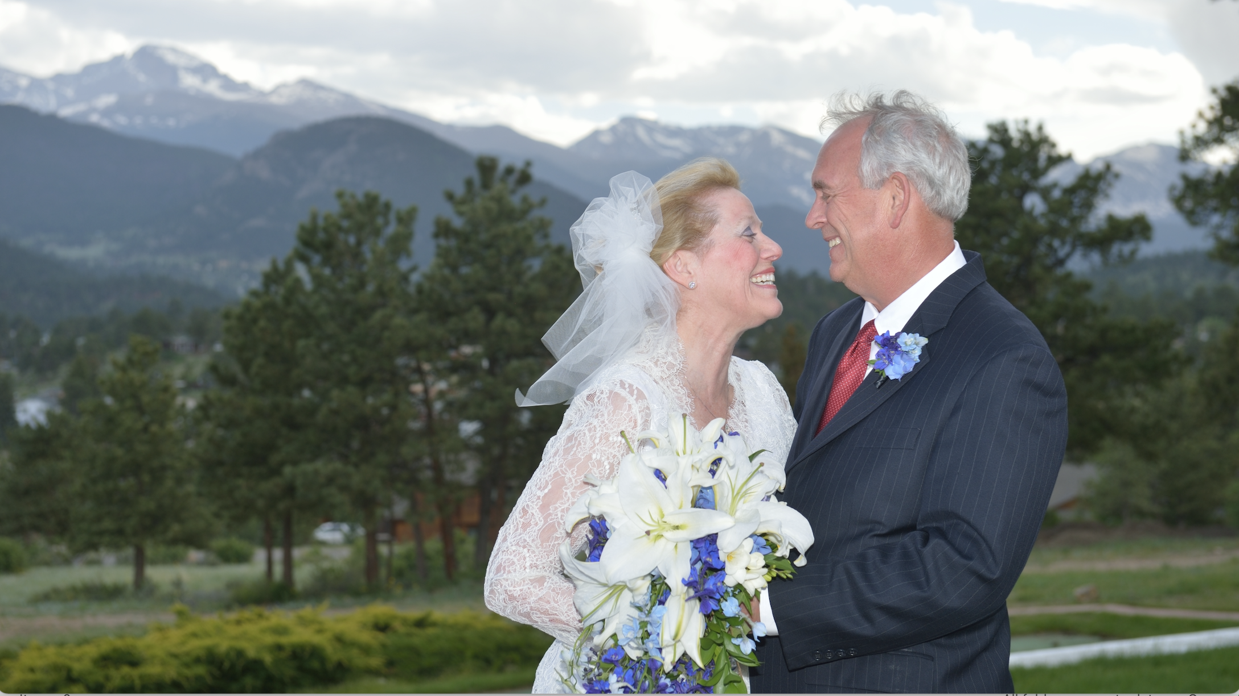
Lynn and Patricia at their wedding in Estes, Colorado, June 15, 2013.

Slide 10
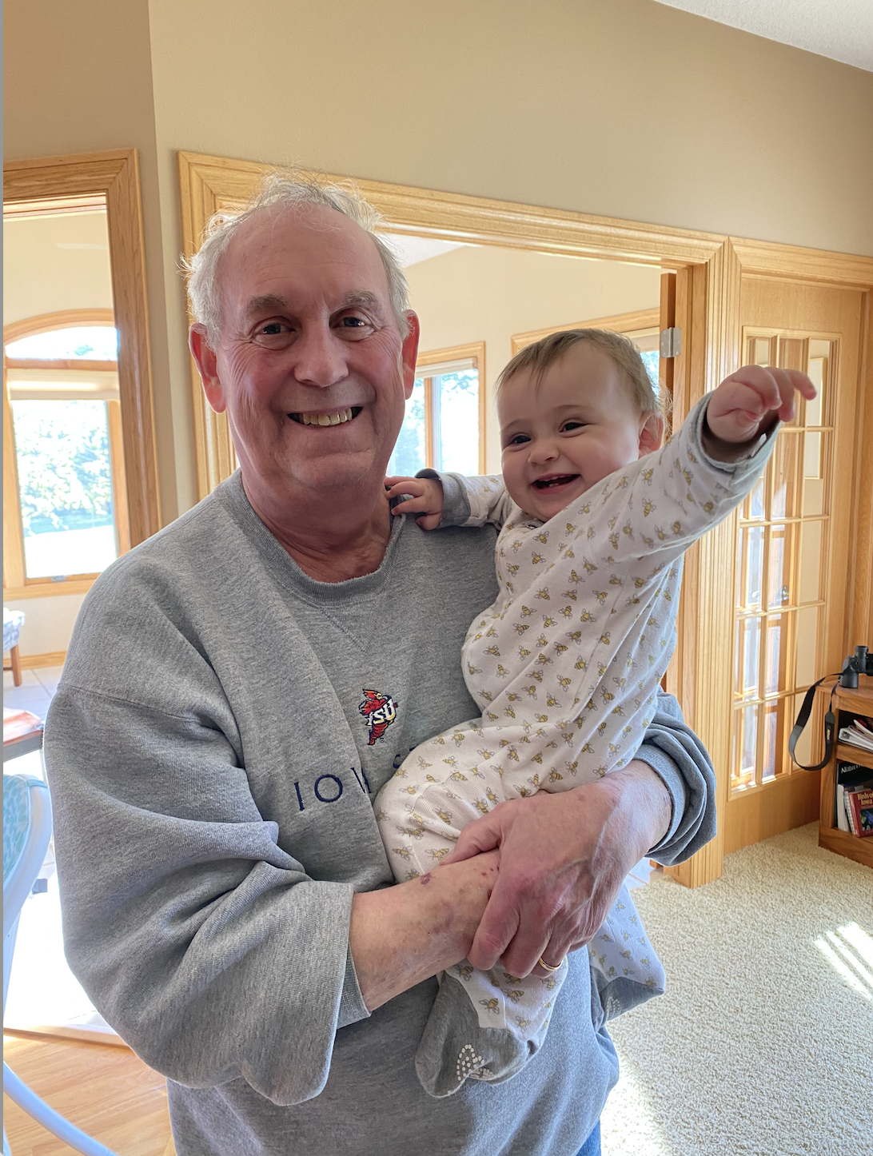
Lynn is a Grandpa!
Lynn has two children, Eric, who lives in Salt Lake City; and Ellyn, who lives with her husband Tyler in Columbia, Maryland.
In July of 2020, they were blessed with their first grandchild, Lily Marie. She has stolen Grandpa’s heart.

Slide 11
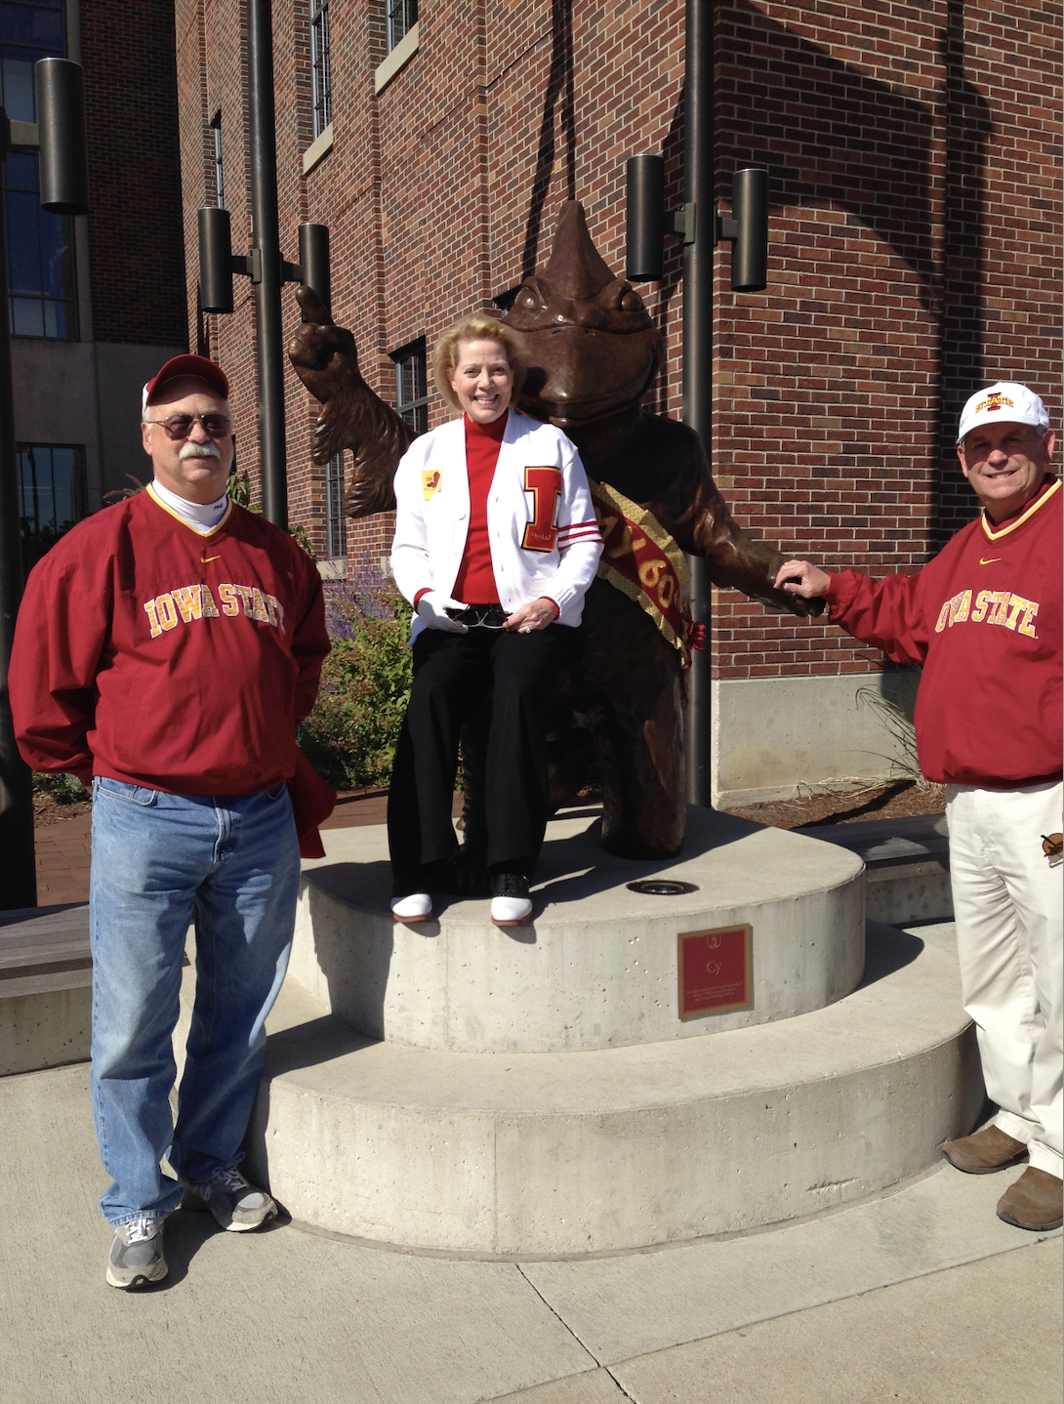

Lynn, Patricia and Kent (Dr. Kent Henderson, Lynn’s brother)
cheering on our Cyclones in Ames.
2018

Slide 12
Here’s what Lynn’s
friends and colleagues
say about him and
his career in
ag communications.

Slide 13
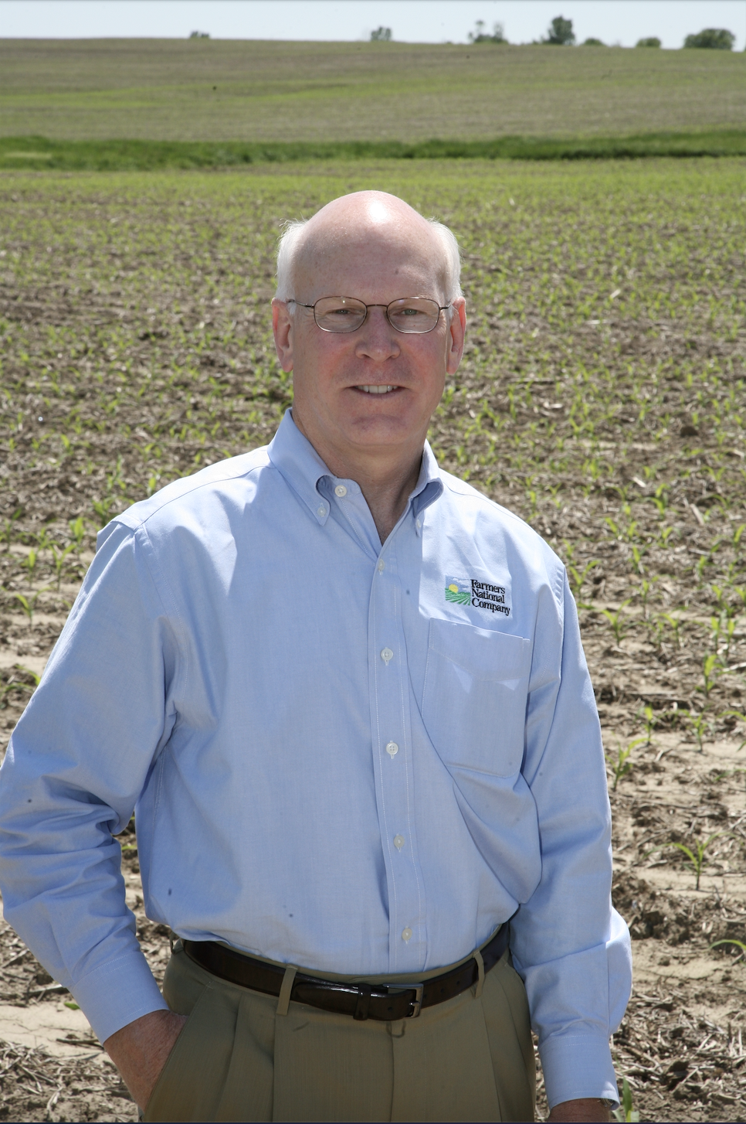
Jim Farrell
Farrell Growth Group
When I think about my career in agriculture since graduating Iowa State University in 1976, there are a few people who stand out in my mind as strong leaders and great advocates for our industry. Lynn is at the top of that list. He has been a tireless supporter of agriculture for the 40 years that we have worked together. On a more personal note, he has been a great supporter to me during my career. But most importantly, he has been a good friend to both me, and my brother. Congratulations Lynn on this well-deserved recognition!

Slide 14
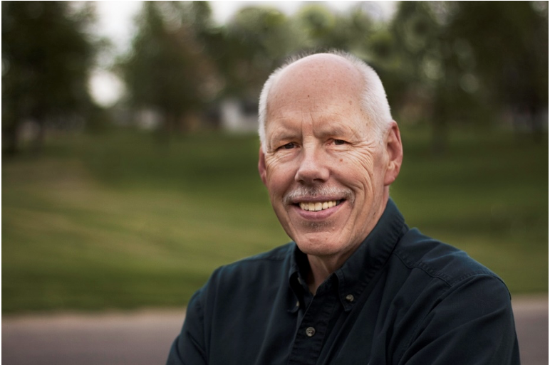
Mike Gustafson
Deer's Landing Communication
“You’d be hard pressed to find a corner of ag marketing communications that has not been touched by the talents of Lynn Henderson. His knowledge of the industry, extensive contacts and willingness to take risks have worked to make our business better. Lynn revels not only in bringing news to readers, but also in offering educational information, comments from ag leaders and viewpoints on the future.
“I’ve been extremely fortunate to have had the chance to assist Lynn in his great adventure, writing and editing for
Agri Marketing magazine and Rural Marketing News. His support is real and honest. His creativity, a force.”

Slide 15
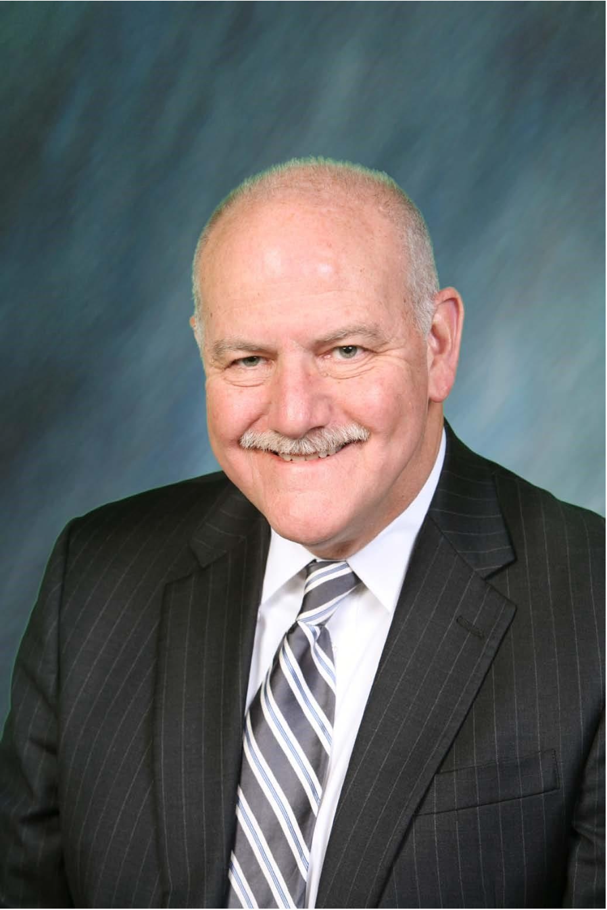
Hugh Whaley
Advisor and Board Secretary at Beck Ag, Inc.
What can I say? Lynn Henderson has been involved in the agricultural community for FOREVER! Maybe it just only seems that way. In 2015, I had the honor of helping induct our mutual friend (and my professional mentor), the late Steve Drake, into the Ag Public Relations Hall of Fame. We miss his presence. However, I know that Steve would have been very proud of Lynn’s selection.
Lynn is omnipresent at all forms of agricultural events. If he is not in attendance, it makes you seriously wonder why YOU are there. I have had the privilege of knowing and working with Lynn for most, if not all, of my ag communications career. As we all know, he and the Agri Marketing franchise are inextricably linked. That’s how I first became familiar with his presence and influence, and it’s where his presence and influence still resides many decades later.
Lynn is an evergreen supporter and active participant of many agricultural educational foundations and organizations. For his continual and unrelenting support of all-things agriculture, Lynn Henderson is a worthy inductee into the ARC Hall of Fame.

Slide 16
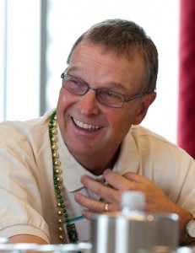
Den Gardner
Gardner & Gardner Communications
In 1995, Lynn contacted me about finding someone to run a relatively new magazine called Ag Retailer, designed just for fertilizer/chemical dealers across the country. I was thinking of going off on my own after a decade with Shandwick and had known Lynn for a long time. He was a shrewd and successful businessman who had an ability to know niche audiences and fill a need for them. I said I knew that person.
Thus started my business, which resulted in a 10-year consulting contract with Lynn that included serving as associate publisher/editor of Ag Retailer magazine and as a columnist for Agri Marketing magazine on public relations. It was a great run. After that, Lynn and I collaborated on many projects with such great communications organizations like AAEA and ARC. He is always a straight-shooter, and always fair.
His support for ARC has been great-as he appreciates the great contributions public relations and public affairs experts make to the ag industry. This is well deserved Lynn. I’m proud to call you a friend. And although it’s a favorite humorous phrase in Minnesota to say: “Who hates Iowa? We hate Iowa,” it’s not true when it comes to Lynn and his Iowa State Cyclones.

Slide 17
Ron Clausen
Ag Media Research Surveys
I joined Ag Communicators of Tomorrow, ACT, in 1970; NAMA in 1974; and NAFB in 1994. So, I’ve known of Lynn Henderson for a long time. But I started getting to know Lynn in the mid ’90s.
Make no mistake about it, Lynn is Agri Marketing magazine. And through Agri Marketing, and his many other services to agriculture, Lynn is a glue that keeps us, ag communicators and marketers, connected.

Slide 18
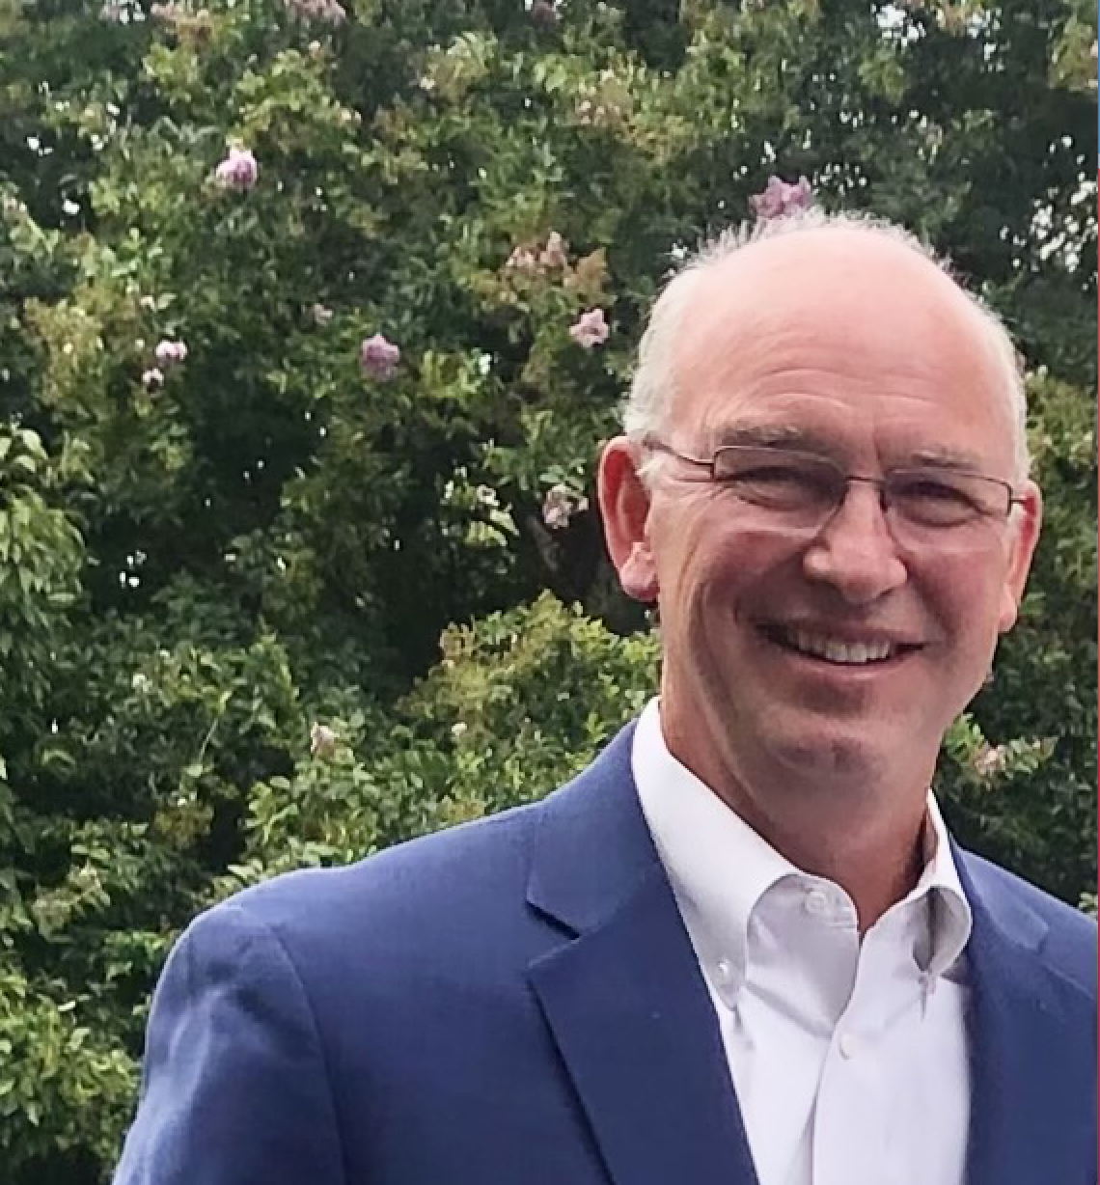
Rick Patton
EVP, Agriculture Sales & Marketing Rural Media Group
Lynn has been a significant contributor to the ag communications industry over the years, building bridges between manufacturers, marketers and the many facets of agriculture. I had the privilege of working for Lynn at Doane, witnessing first-hand his leadership, drive for excellence and outstanding people skills.
The Agri Marketing brand and portfolio of platforms continues to thrive via Lynn’s direction, and all of us engaged in the marketing communications segment of agriculture are indebted to Lynn for his continued passion to connect our industry.
Congratulations on this honor Lynn – you’ve earned it.

Slide 19
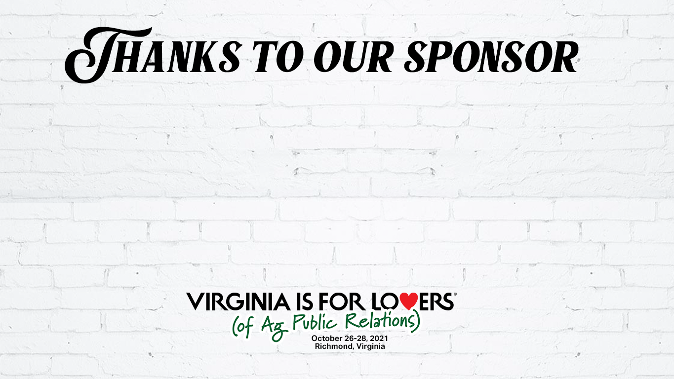
Agri Marketing and Lynn Henderson
have been proud sponsors of the
Agricultural Public Relations Hall of Fame
since its inception in 2012.

Slide 20
